Slide 1

FoodBIZ
Members:
Deepak Arora
Mohammad Shahabi Nejad
Jaimeet Singh Suri
Naishadh Allamudi
Piyush Dangwal
Vatsarajan Candhadai Ramaswamy

Slide 2


CONTENTS 1. objective 2. proposed solution 3. CONTEXT DIAGRAM 4. use case diagram 5. User interface design 6. future scope

Slide 3
OBJECTIVE 1. To be able to track famous food across the globe and in the current location to get the taste of the best food around not by rating but by popularity 2. To be able to track the best-selling food in the restaurant and currently on-going food orders to provide insights on improvement for business 3. To reduce wastage of food by limiting orders 4. To keep track of our eating habits and learn more about our taste buds

Slide 4
PROPOSED SOLUTION
1. Analyze the eating habits of people in different demographics to provide the business on how to approach a specific customer with offers
2. Distinguish food based on portion to avoid food wastage from the data provided by the customers and the restaurant owner
3. Tracks the demand of food based on location to provide insights for the business owners
4. Tracks popular food rather than restaurants based on the location of the customer

Slide 5
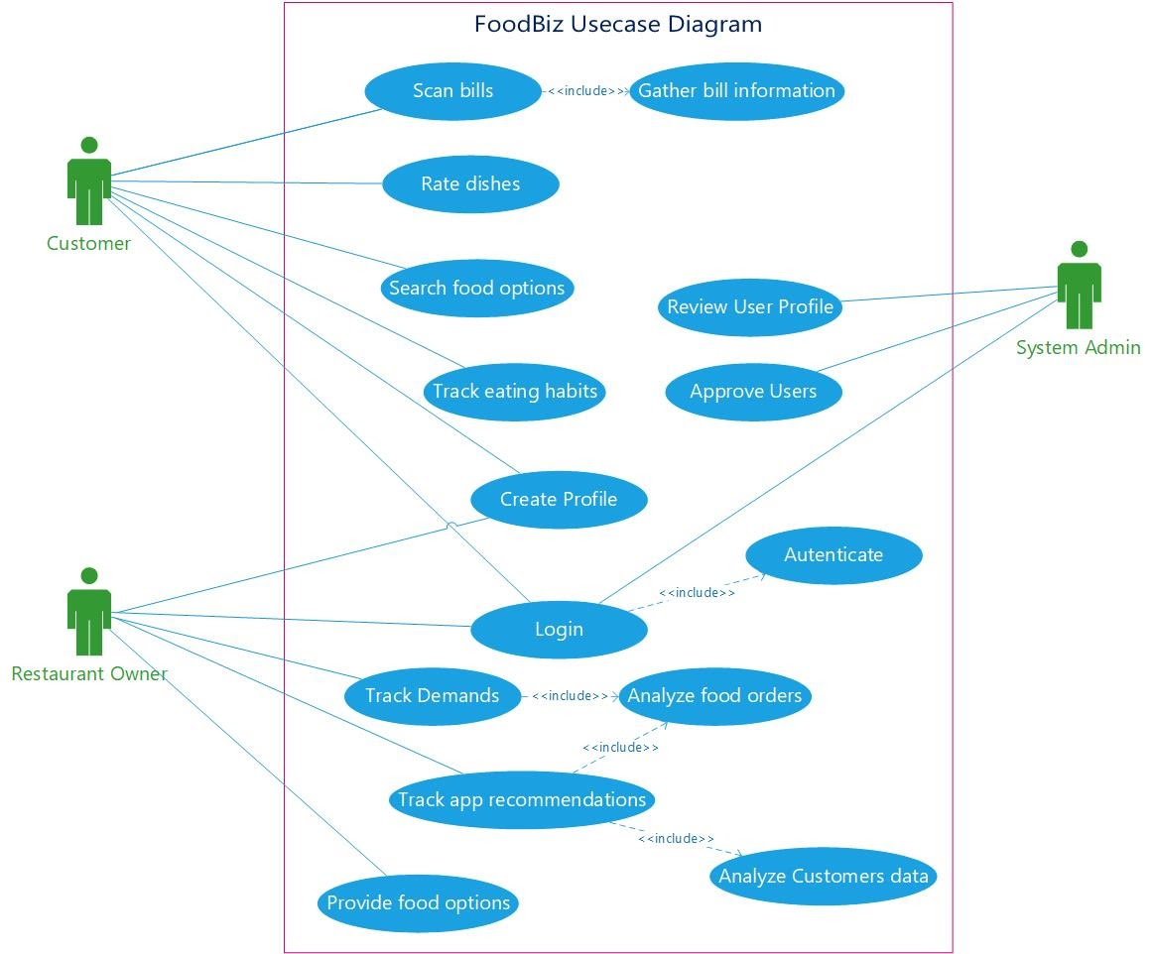
Use case diagram:

Slide 6
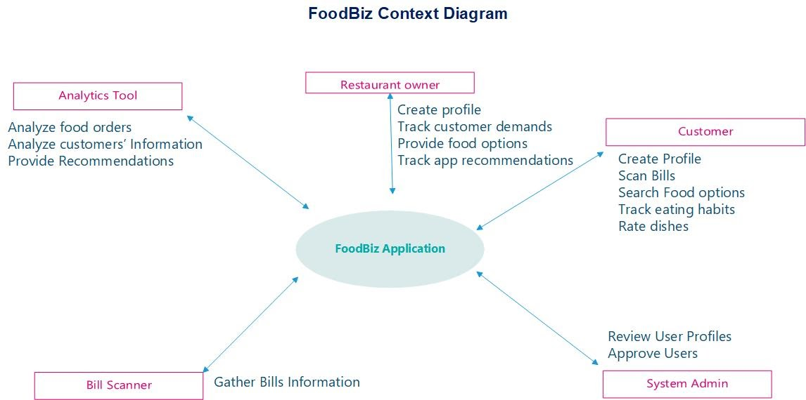
CONTEXT DIAGRAM:

Slide 7
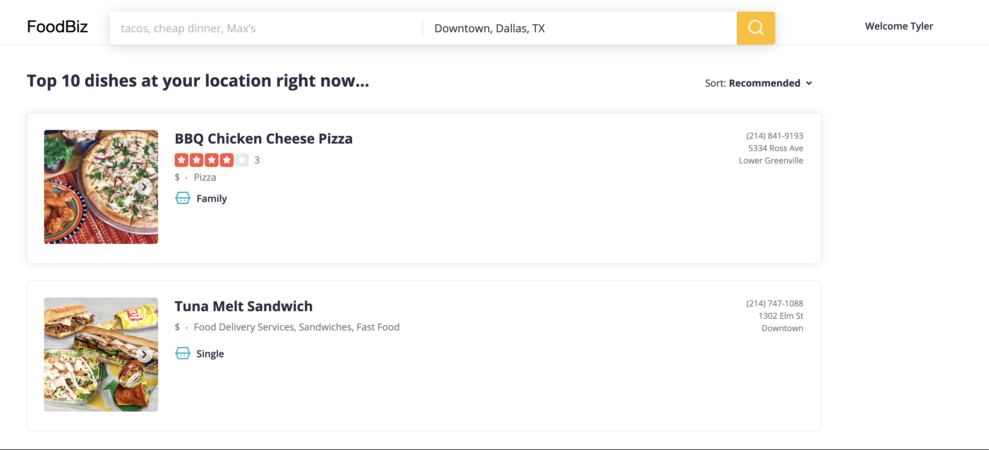
USER interface designs:
1. User home screen
TO BE CONTINUED…

Slide 8
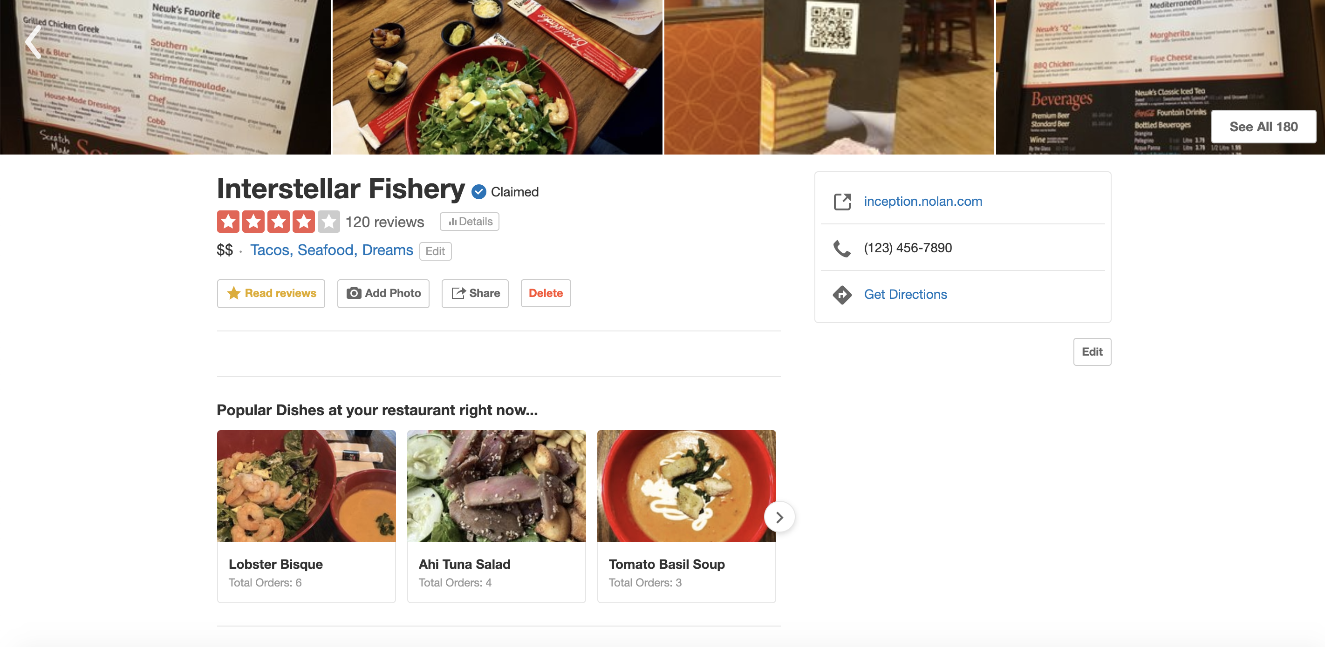
USER interface designs:
2. Business owner home screen
TO BE CONTINUED…

Slide 9
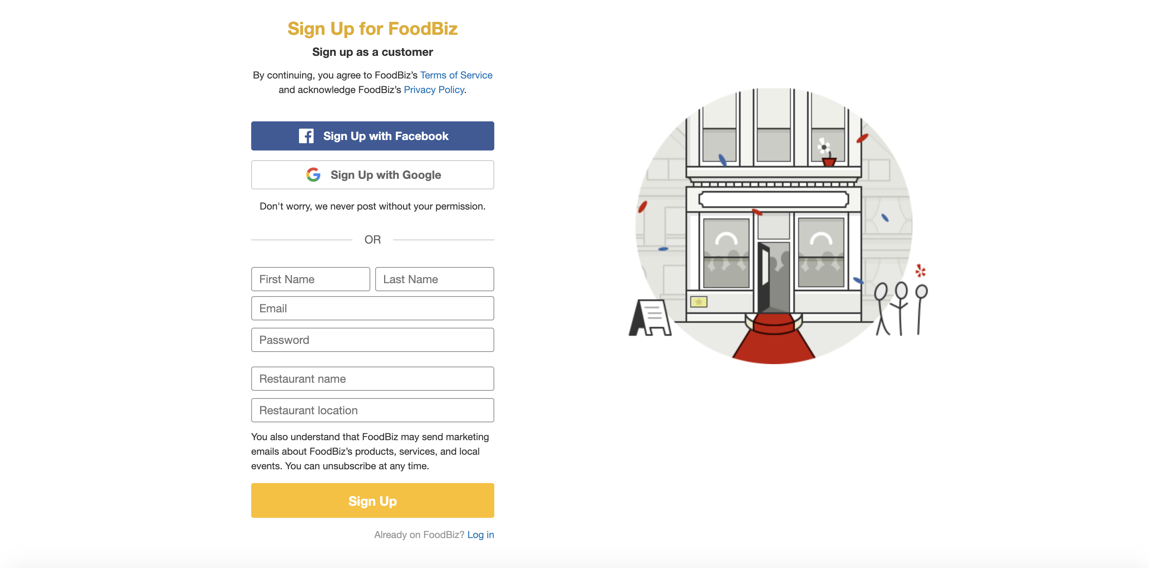
USER interface designs:
3. Customer sign up screen
TO BE CONTINUED…

Slide 10
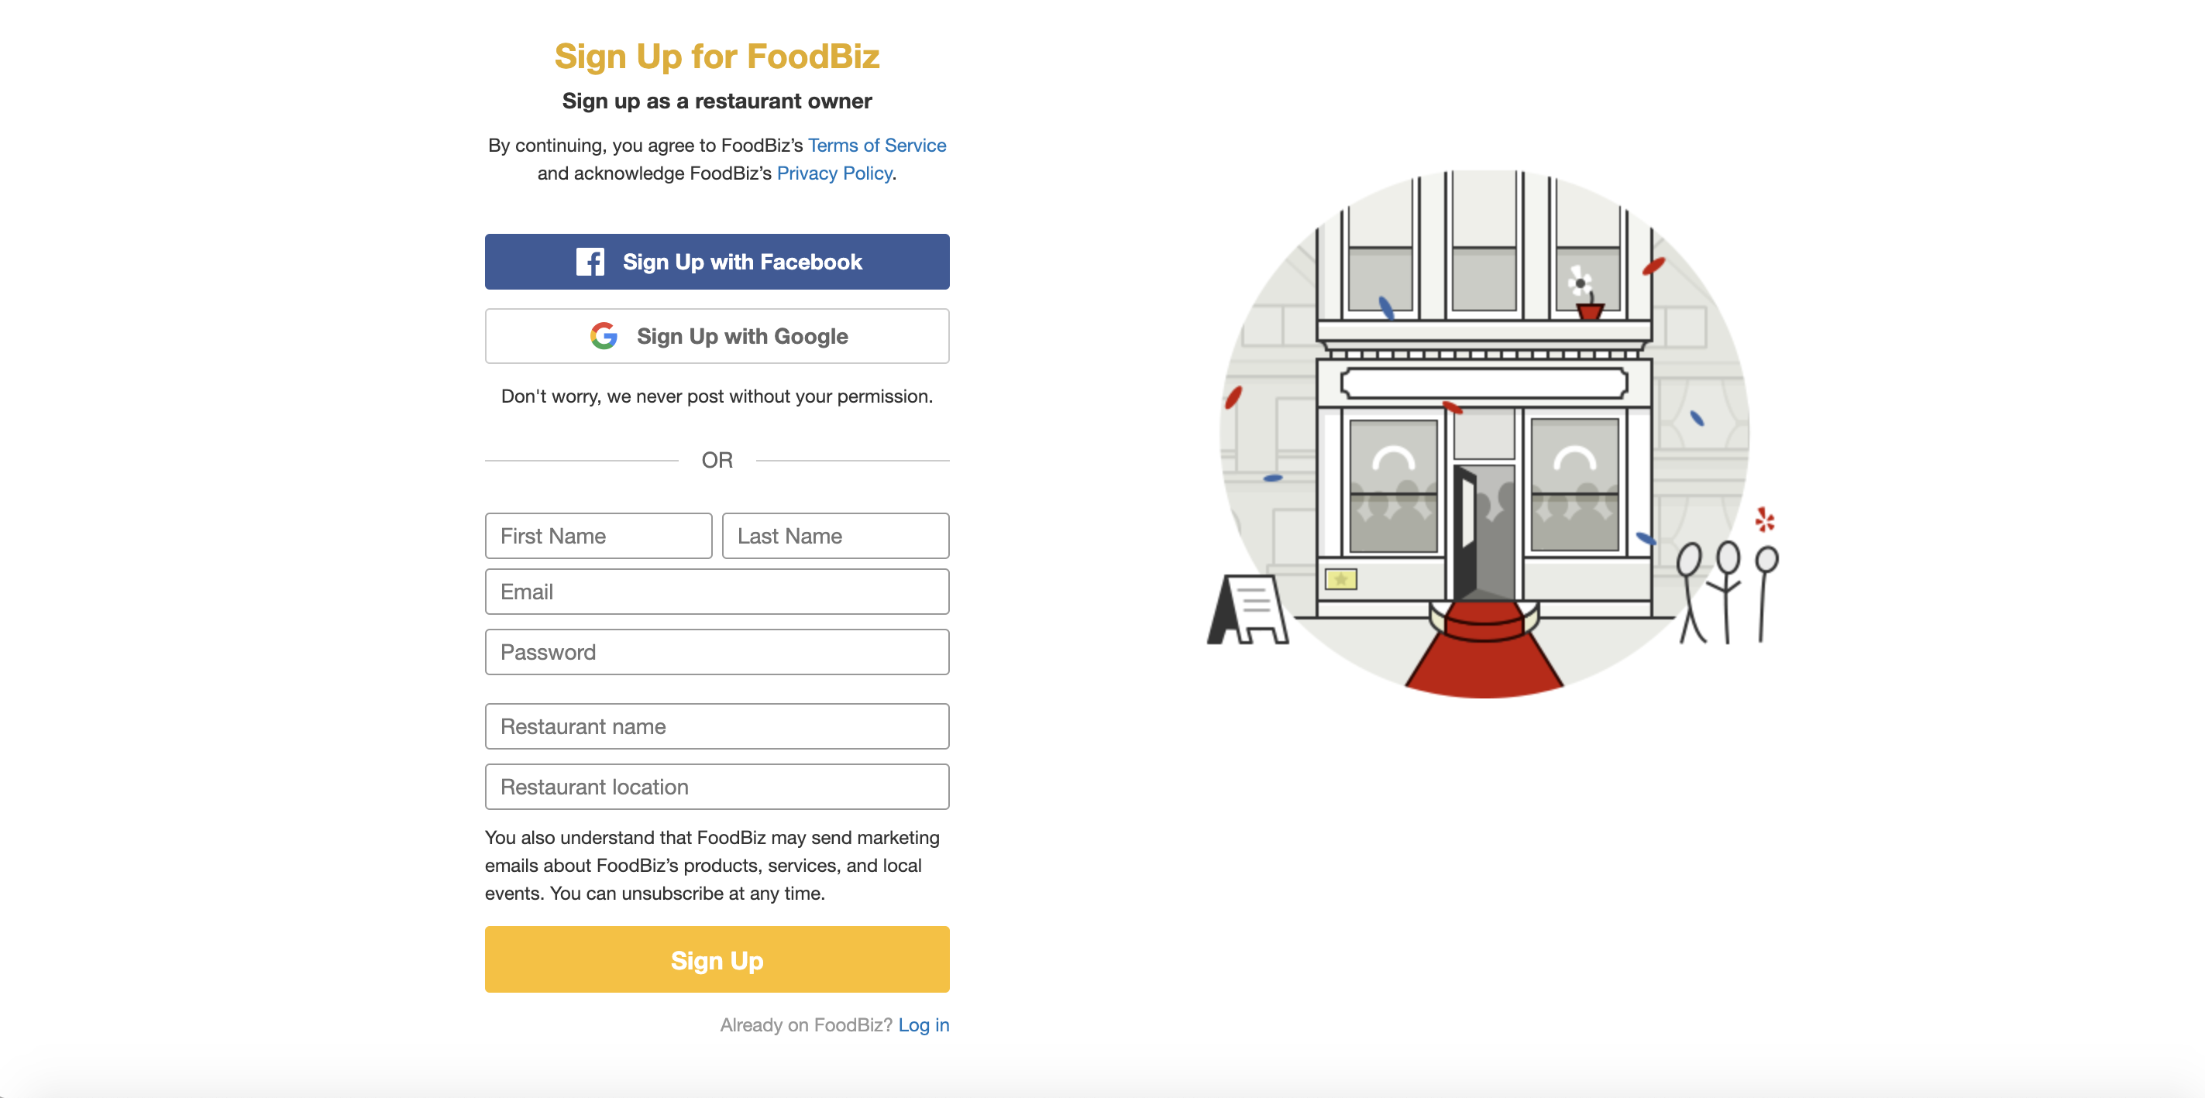
USER interface designs:
3. Business owner sign up screen

Slide 11
FUTURE SCOPE
1. Create a hybrid web application to support Desktop, Mobile and Tablet devices
2. Make use of geo-location through Google geo-location API and get directions to the restaurant
3. Collaborate with delivery services like Grubhub, Doordash etc to provide delivery services through our application
4. Analyze customer data through the bills the user uploaded and provide suggestions to the user based on their current location
5. Bind their health-related data through the Health app in iOS and Samsung Health in Android and create beautiful visualizations in the FoodBiz app

Slide 12
THANK YOU FOR YOUR TIME AND PATIENCE

Slide 13
QUESTIONNAIRE TIME AND FEEDBACK

